Slide 1

Pitch Deck
NEW BUSINESS OPPORTUNITY
Henrietta Mitchell, Founder & CEO
Matt Zhang, Founder & CTO
13 September, 2023
Ingoude Company

Slide 2
TASK
Develop an interactive web application for Deep learning with Flask, model serving, Docker and DevOps Best Practices.

Slide 3
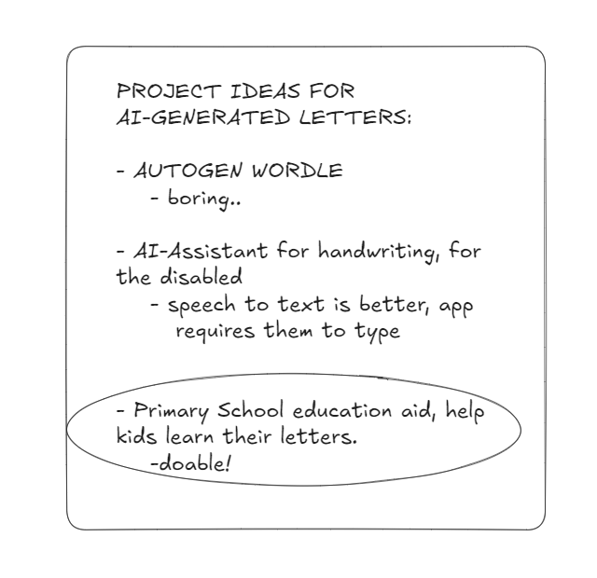
PRE-PLANNING (IDEATION)
Before starting any planning, I ideated on the theme that I would like my project to have, and its target audience. I decided on an app to help young kids learn their English letters in a fun way!

Slide 4
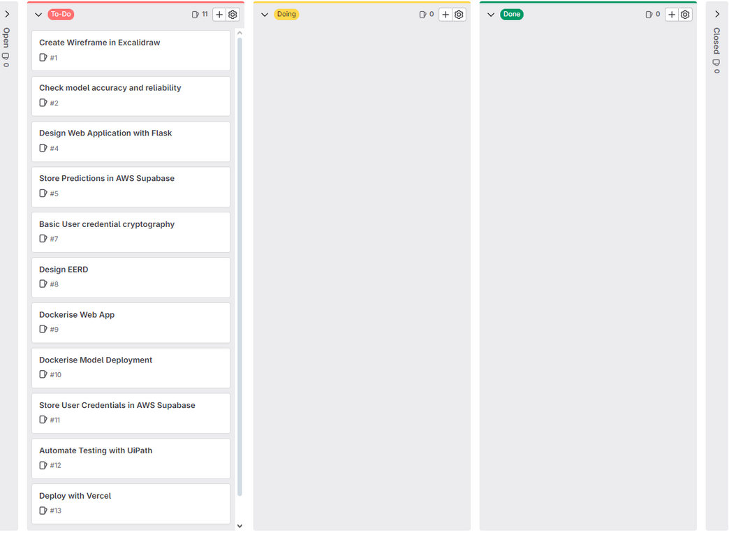
PRE-PLANNING (SCRUM BOARD)
In order to prepare for the project efficiently, I first created a SCRUM board with GitLab, to ideate, identify user needs, and break down large Product Backlog Items (PBIs) to smaller tasks.

Slide 5
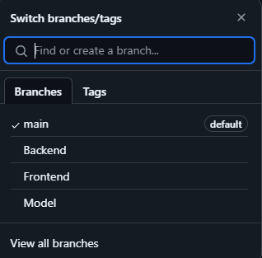




PRE-PLANNING (GIT SETUP & TECH STACK)
Server
Dockerised Models
Flask
Database
(Tensorfow/Serving)
AWS Supabase
I then created my repository, and created the core branches that would make up my project. Thereafter, I decided on the tech stack that would make my project happen.

Slide 6
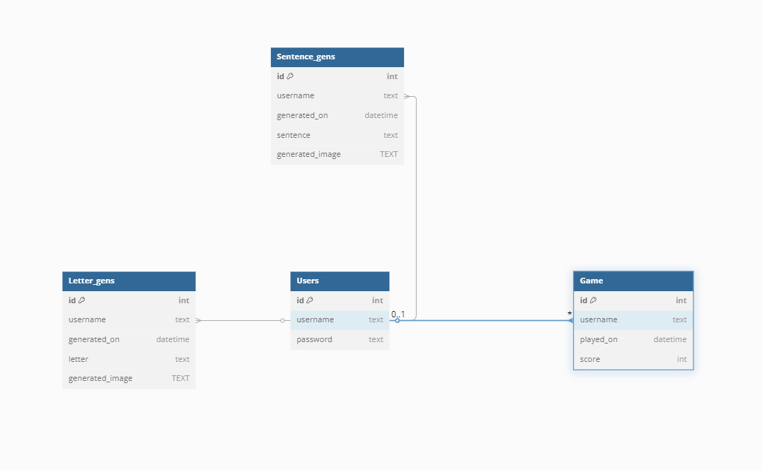
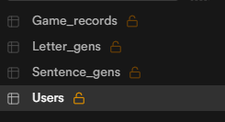
PRE-PLANNING (AWS SUPABASE SETUP)
After the tech stack was decided, I planned out my database schema as shown above, with Users being the central table that all other tables would reference. This makes it easy to manage FK references, and operations like ON DELETE CASCADE when I have to remove a user.

Slide 7
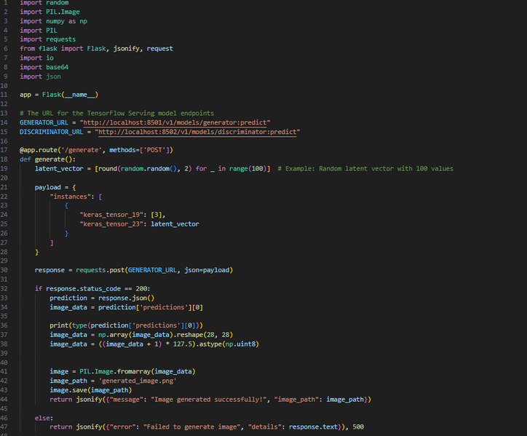
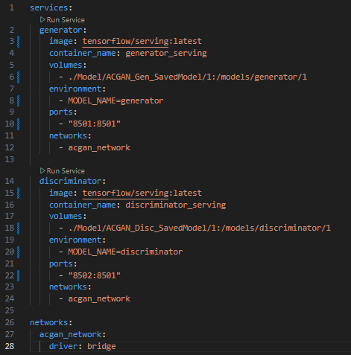
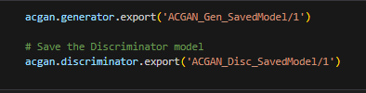
IMPLEMENTATION (DOCKER COMPOSE SETUP)
Testing functions of docker containers
Final docker-compose.yml
saving models in SavedModel format
Before creating the rest of my project, I first made sure I could access both my ACGAN Generator and Discriminator models using Docker Compose. This step turned out to be one of the hardest, taking many hours of debugging before getting working containers.

Slide 8
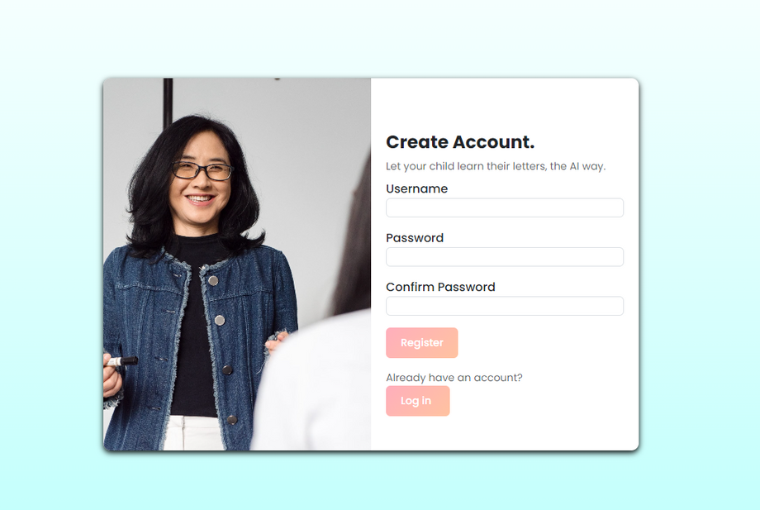
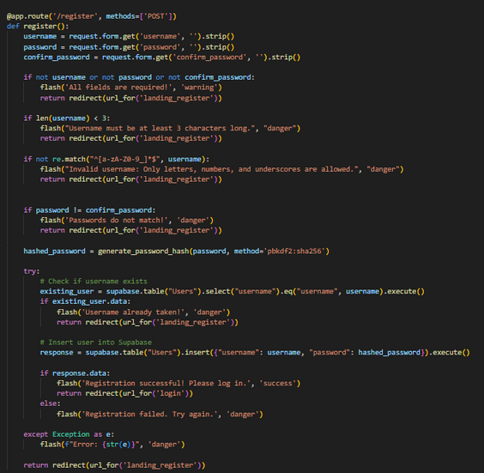
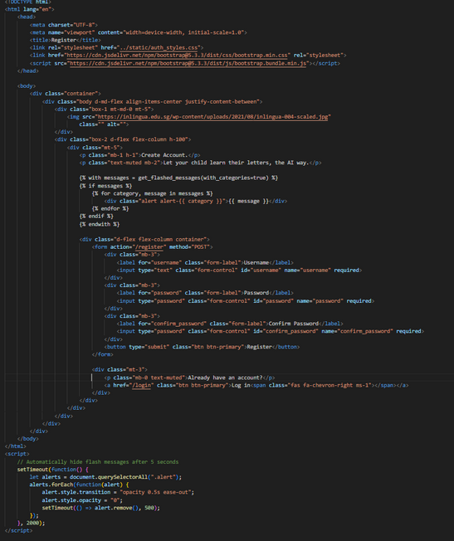
WEB APP DEVELOPMENT: REGISTER/LOGIN
Webpage Preview
app.py, register endpoint
landing_register.html
The first webpage I created was my landing page (which also serves as registration), taking inspiration from registration pages online for a fun and modern look. Throughout the process, I used VSCode’s “Open in default browser” extension to easily preview my webpages.

Slide 9
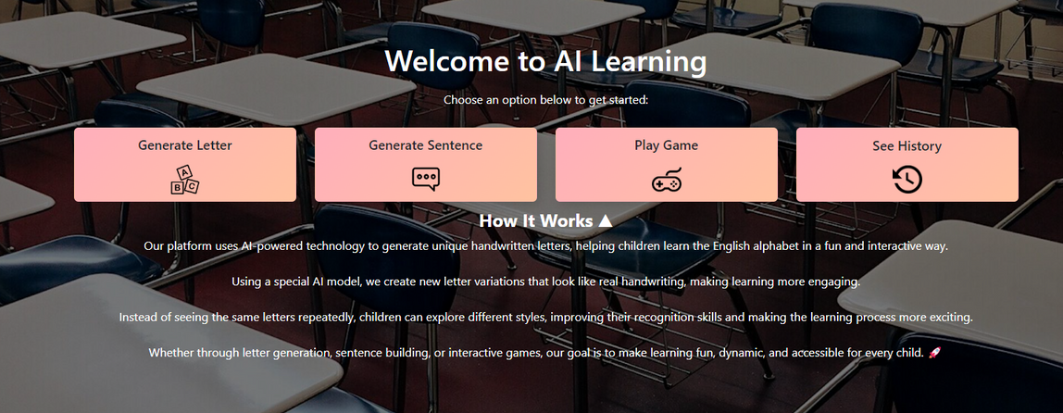
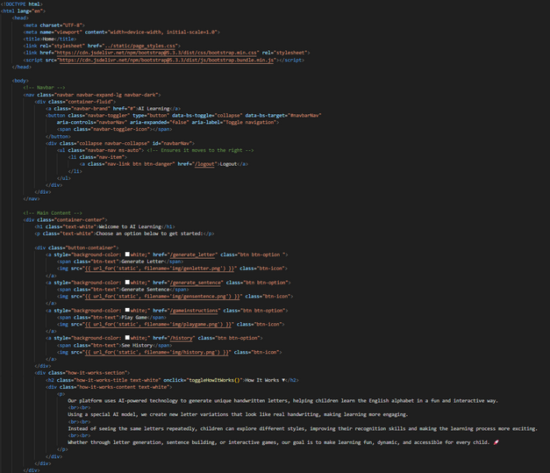
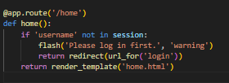
WEB APP DEVELOPMENT: HOME
part of home.html
app.py, home endpoint
Next, I made my homepage, which serves as the hub for all other functions of my website. It’s crucial here that the homepage is attractive and vibrant, as the user will be returning to this page alot. I’m quite proud of the design!

Slide 10
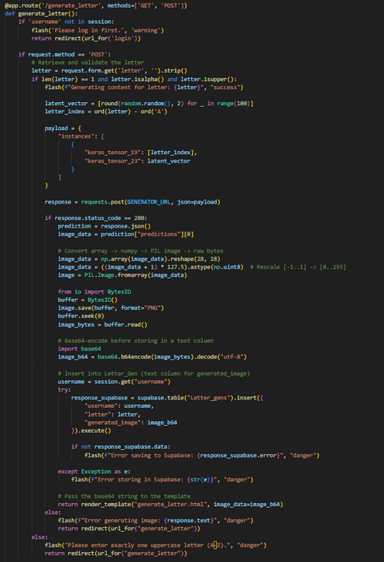
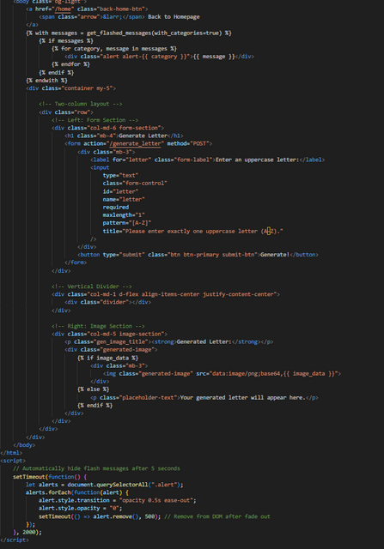
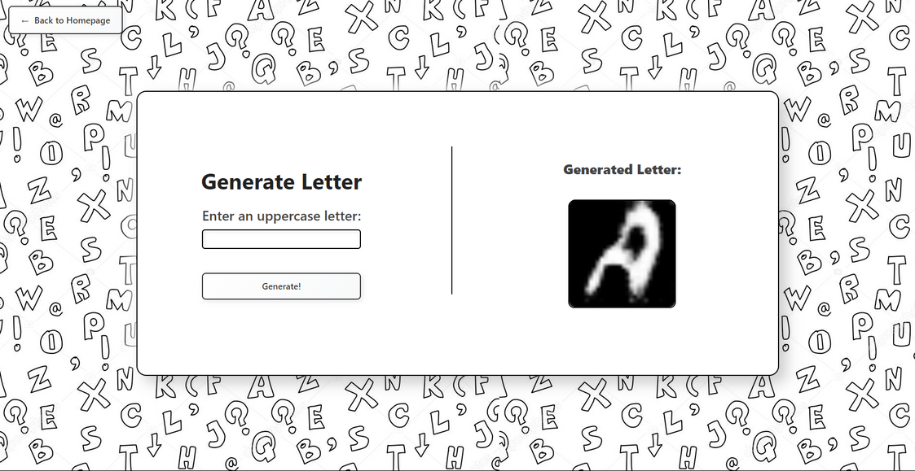
WEB APP DEVELOPMENT: LETTER GENERATION
app.py, /generate_letter endpoint
part of generate_letter.html
Here is the first of my website’s core functions: Generating a letter using the dockerised model. The website ensures validity of inputs, making sure the user can only enter one character, and it must be an uppercase english character. If not, an error is thrown. Each generated character is stored in AWS Supabase, after being encoded in base64.

Slide 11
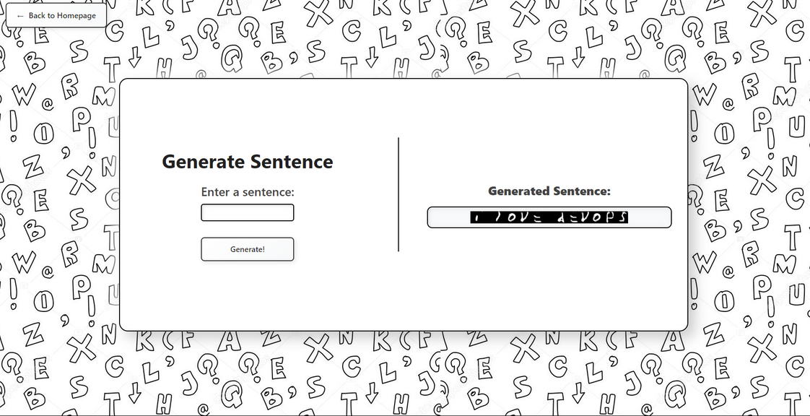
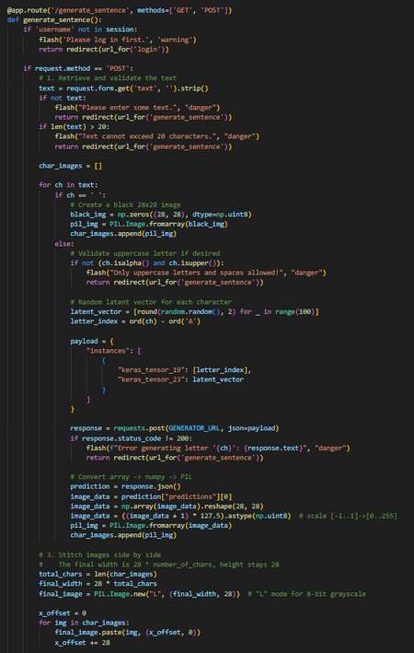
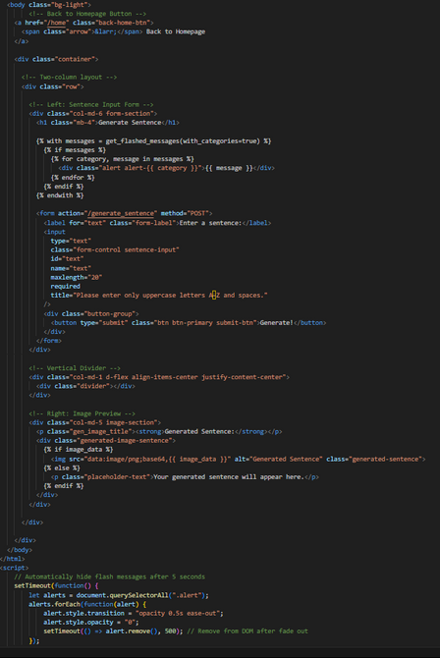
WEB APP DEVELOPMENT: SENTENCE GENERATION
app.py, /generate_sentence endpoint (part)
part of generate_sentence.html
Next, another of my website’s core functions: Generating a sentence (up to 20 characters for size) using the dockerised model. While the model cannot generate empty spaces, I used NumPy and PIL to generate the black squares for spaces, stitch all generated images together, and encode it to base64 for storage.

Slide 12
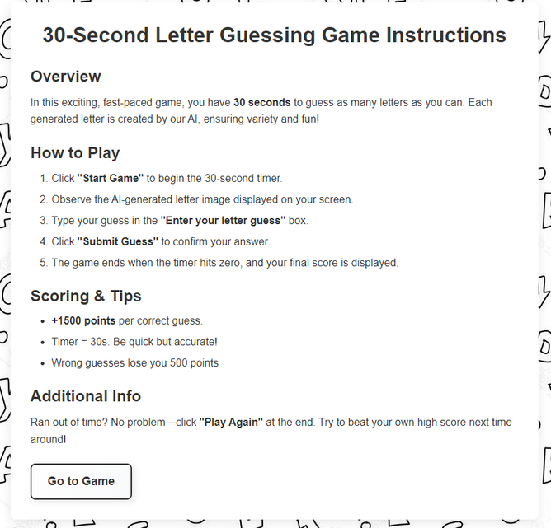
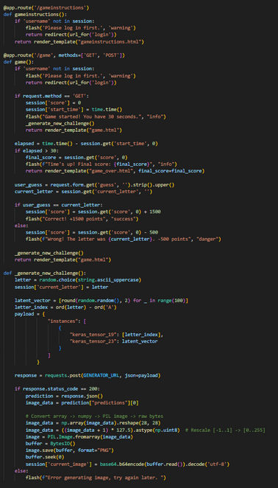
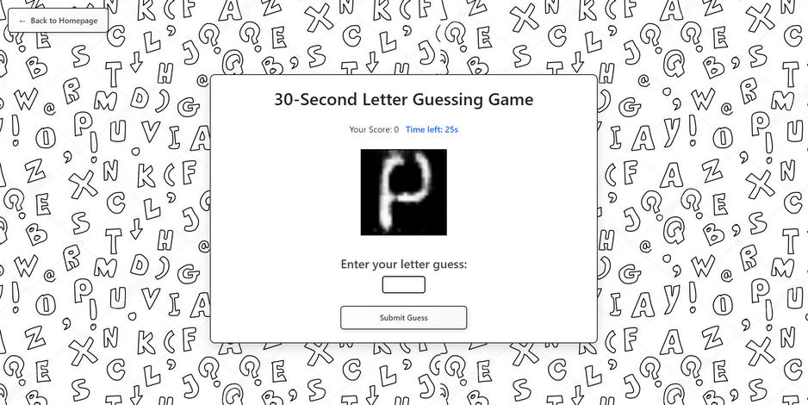
WEB APP DEVELOPMENT: GAME
app.py, /game endpoint (part)
To make my webapp unique, I chose to implement a fast-paced game where the user has 30 seconds to guess as many of the generated letters correctly as possible. I chose this as both a way for my users to practice their english letters, but also to show that AI generations have a limit, as the letters are not perfect.

Slide 13
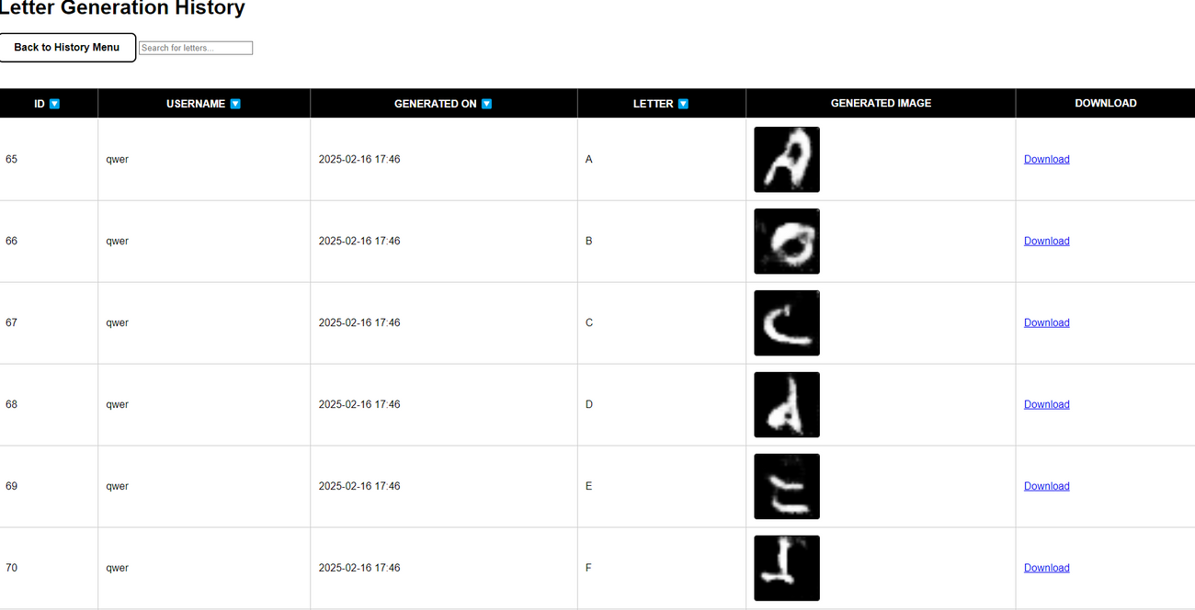
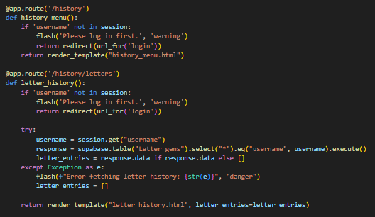
WEB APP DEVELOPMENT: LETTER HISTORY
app.py, /history endpoints
For the generation history, I showed all relevant info in a table format, including generation ID, username, date & time of generation, the character to be generated, and the final generated image. There’s also a download link for each generation, if the user wishes to download. Here, the user can also filter for date ascending/descending and filter for letters

Slide 14
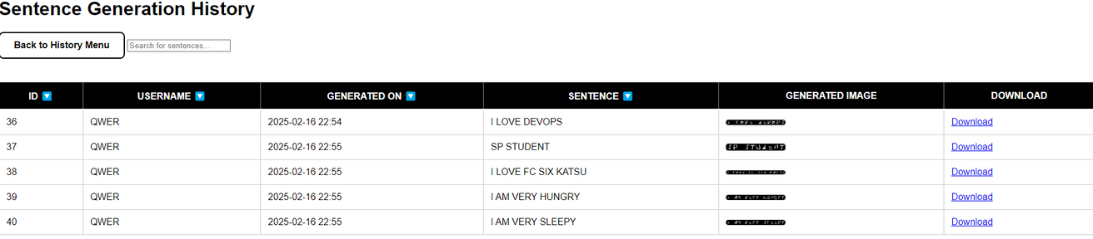
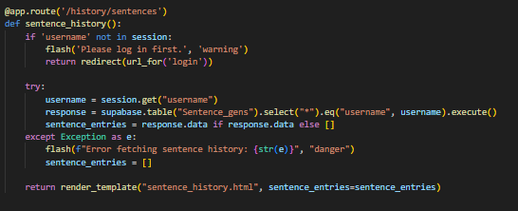
WEB APP DEVELOPMENT: SENTENCE HISTORY
app.py, /history/sentences
Similar history page for sentences and letters.

Slide 15
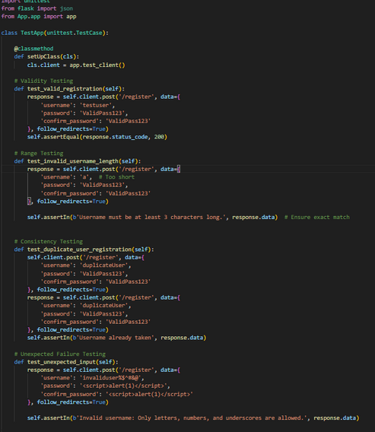
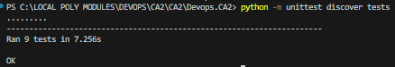
PYTEST FOR AUTOTESTING
some cases in test.py
Now that the core functions were complete, I set up test.py to perform unit and REST API endpoint testing with unittest. I tested for invalid usernames, mismatched passwords, unlogged users, invalid characters in generation input fields, and more. As I performed a lot of client-side input validation, there were not many paths to exploit my web app. The ones that were revealed by unit tests were promptly patched.

Slide 16

ROBOTIC PROCESS AUTOMATION (RPA) FOR TEST
Robotic Process Automation (RPA) is a technology that automates repetitive, rule-based tasks using software robots. In automated testing, RPA is used to streamline test execution and improve efficiency.
Allows for low-code/no-code testing
Highly Scalable
Cost efficient (Selenium is free!!)
In my Project, I chose to use Selenium for my automated testing, due to familiarity and it’s ease of use.

Slide 17
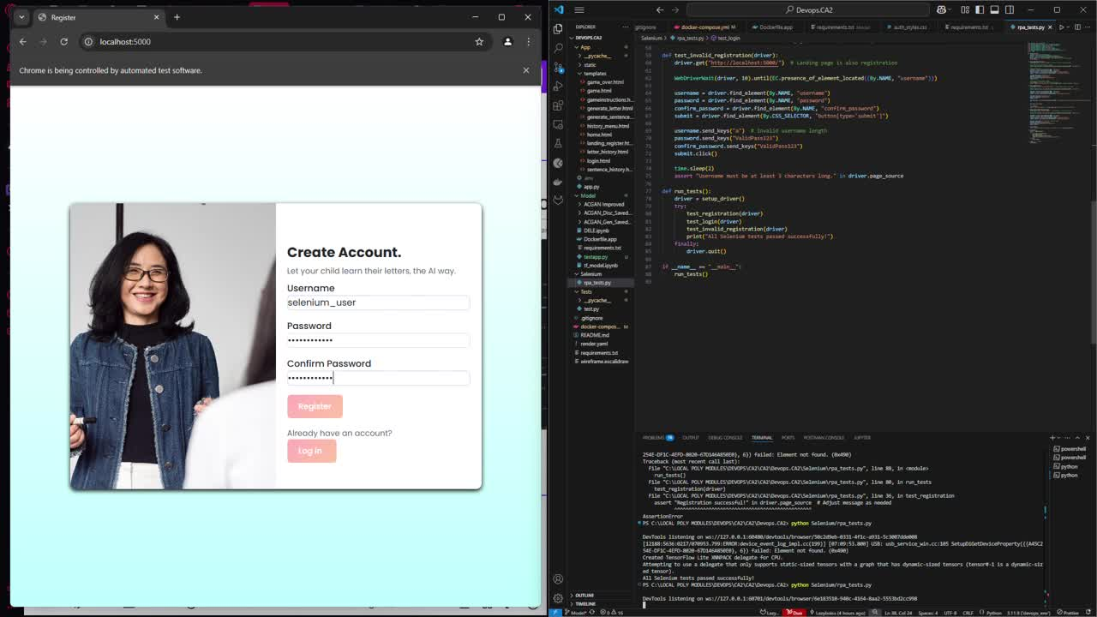
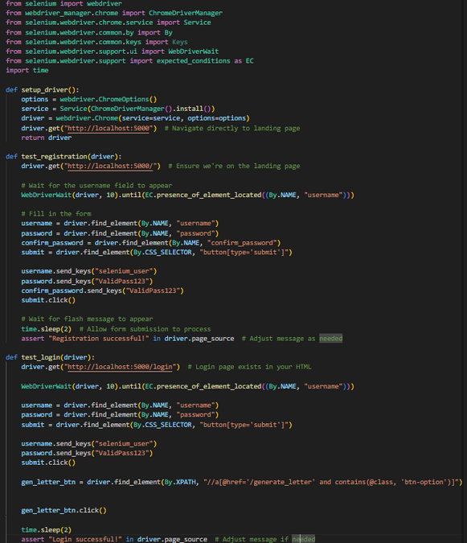
ROBOTIC PROCESS AUTOMATION (RPA) FOR TEST
rpa_tests.py (part)
I set up Selenium to work with Chrome using its webdriver_manager, and tested for multiple testcases for my login and register forms.
Have a look at the demo!

Slide 18
Thank you!

